Slide 1

Minor Project
Computer Networks
Topic- Chatroom in Python using
Socket Programming
Submitted by- Ankush Kashyap(181202)
Prajwal Sharma(181220)
Submitted to- Dr. Jagpreet Sidhu
Batch- CS61

Slide 2
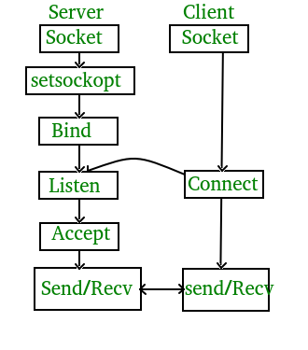
Introduction- Chatroom and Socket programming
Chatroom is a platform where people can communicate with each other. Basically a Chatroom uses the concept of Socket Programming.
A Socket is an intermediate connection between Application layer and Transport layer in TCP/IP protocol. Socket Programming helps in communication between nodes in a network

Slide 3
Modules Used
Socket-This module provides built in methods used to create sockets and enable them to connect to each other and exchange data.
Sys-The sys module in Python provides various functions and variables that are used to manipulate different parts of the Python runtime environment. It provides the system module which is responsible for providing data related to the system directory, functions, and methods.
Time- The Python time module provides many ways of representing time in code, such as objects, numbers, and strings. It also provides functionality other than representing time, like waiting during code execution and measuring the efficiency of your code.

Slide 4
SERVER
Server - The server accepts connections from the client/s and form a network interface. The role of the server is to collect any messages from the client and deliver them to other client.
Steps to implement the server side:
1)Importing the required libraries
2)Creating the socket using socket() and getting the hostname
3)Binding the host and port
4)Listening and accepting incoming connections
5)Delivering messages

Slide 5
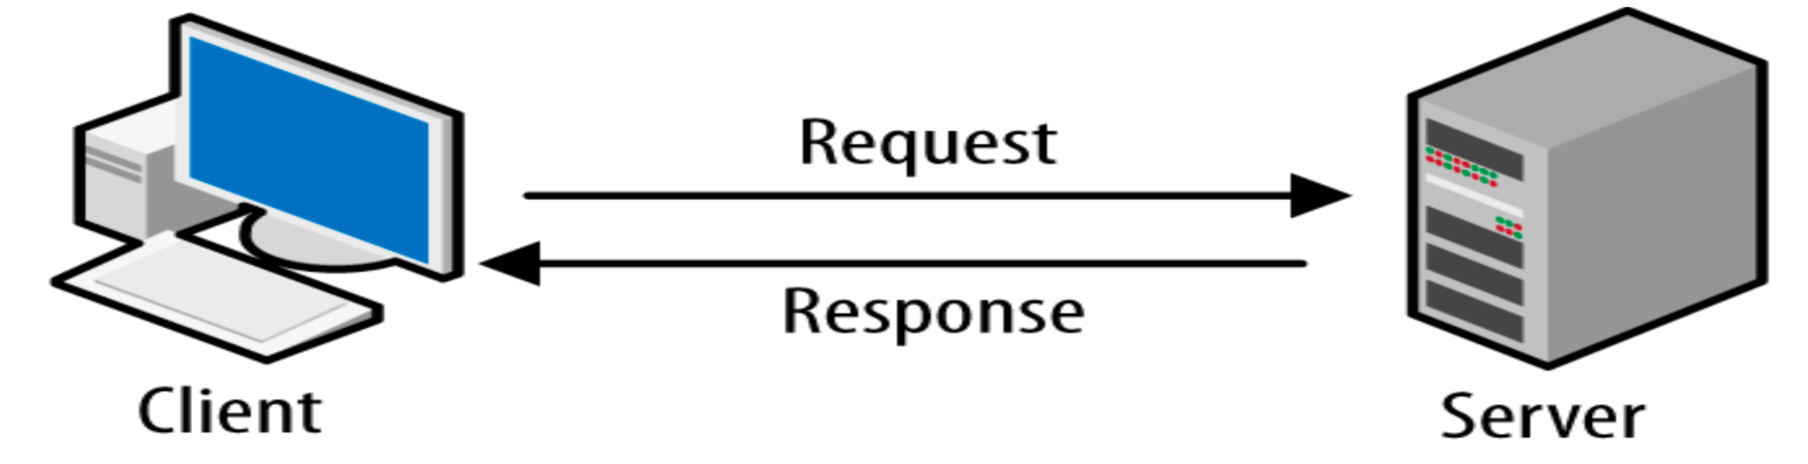
CLIENT
The Client requests the server to form a connection to communicate.
Steps to implement the client side:
1)Importing libraries
2)Creating a socket and retrieving the input hostname
3) Connecting to the server
4)Receiving/sending messages from and to the server

Slide 6
